Slide 1
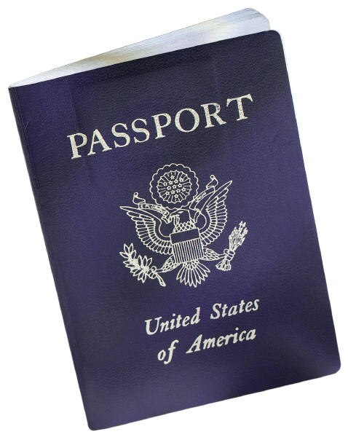
U.S. PASSPORT
APPLICATION INSTRUCTIONS
www.travel.state.gov

Slide 2
U.S. PASSPORT
Processing times are as follows:
Routine Service – 4-6 Weeks
Expedited – 2-3 Weeks

Slide 3
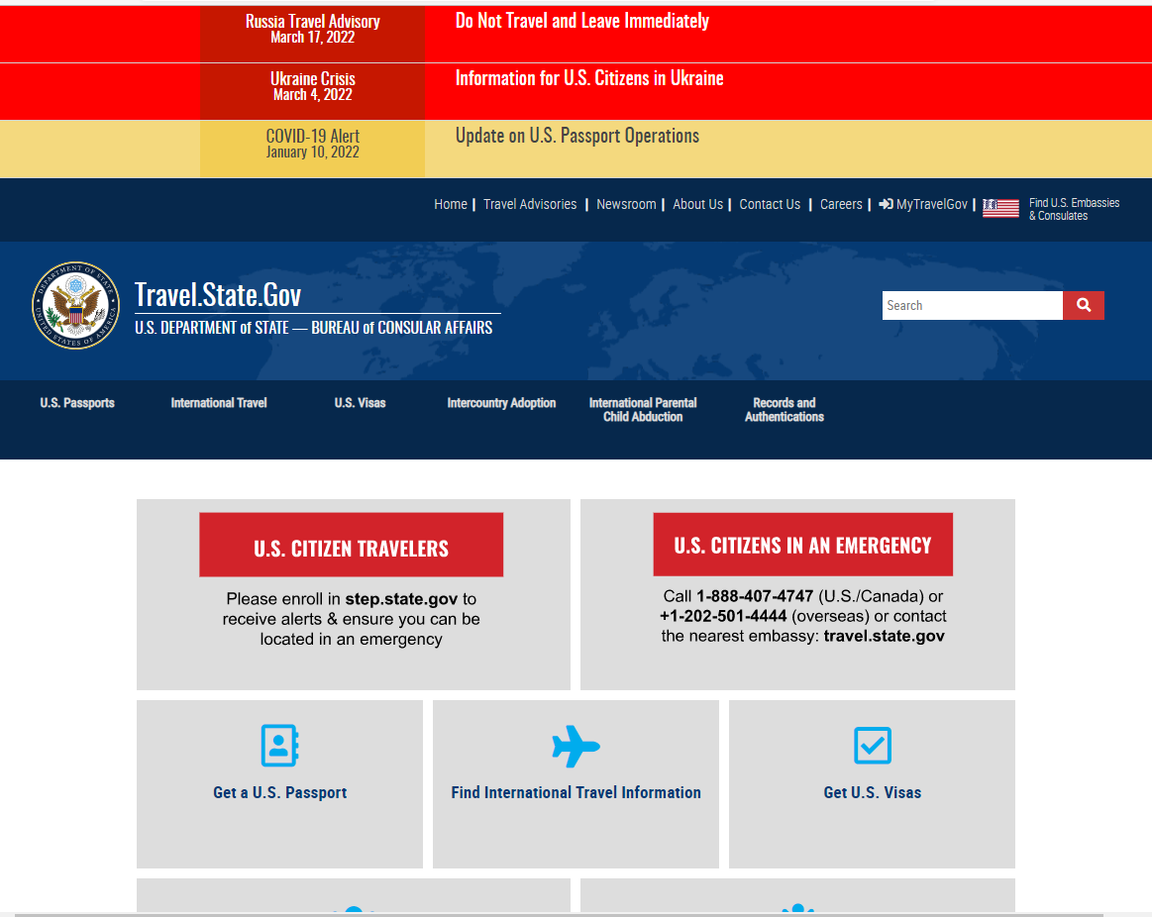
Go to www.travel.state.gov and click on
U.S. Passports

Slide 4
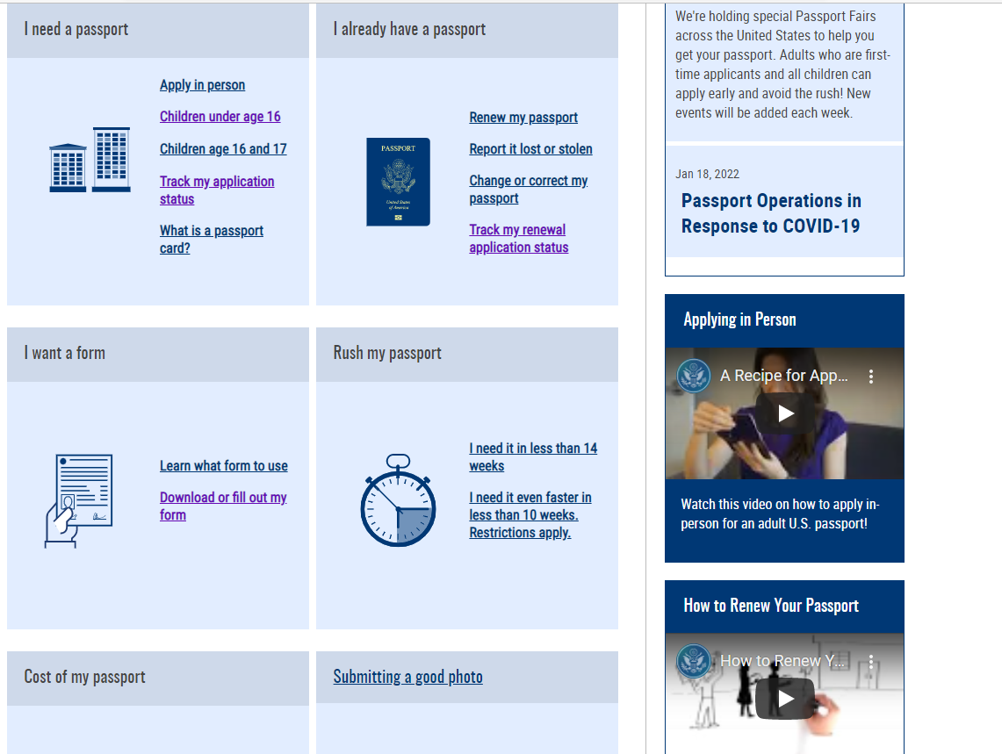
Scroll down to “I want a form” and click on Download or fill out my form

Slide 5
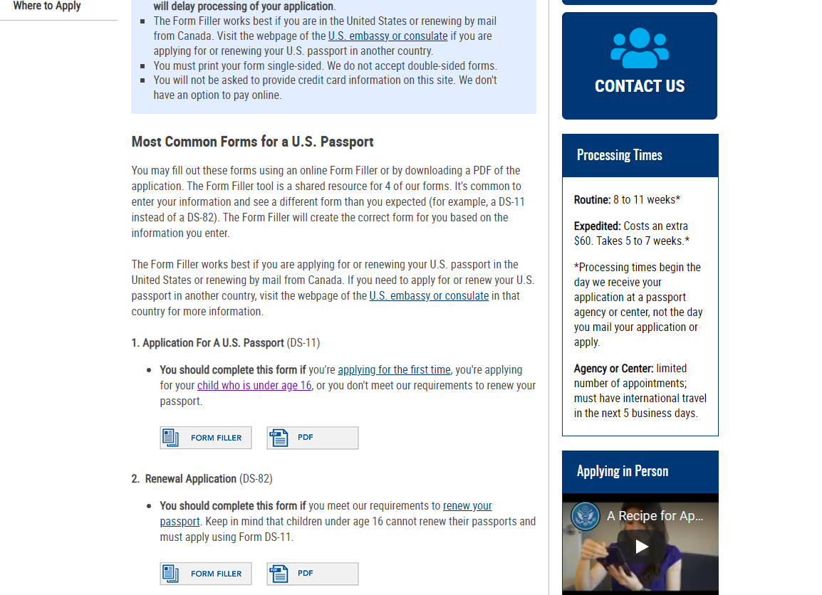
Scroll down to 1. Application for a U.S. Passport (DS-11) and click on FORM FILler.

Slide 6
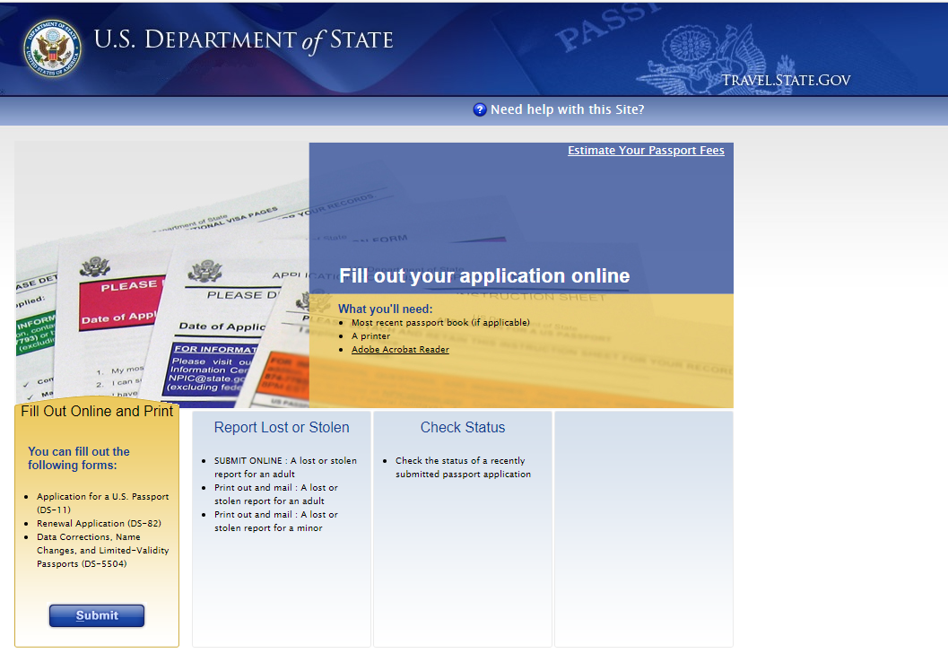
Click on SUBMIT under Fill out Online and Print.

Slide 7
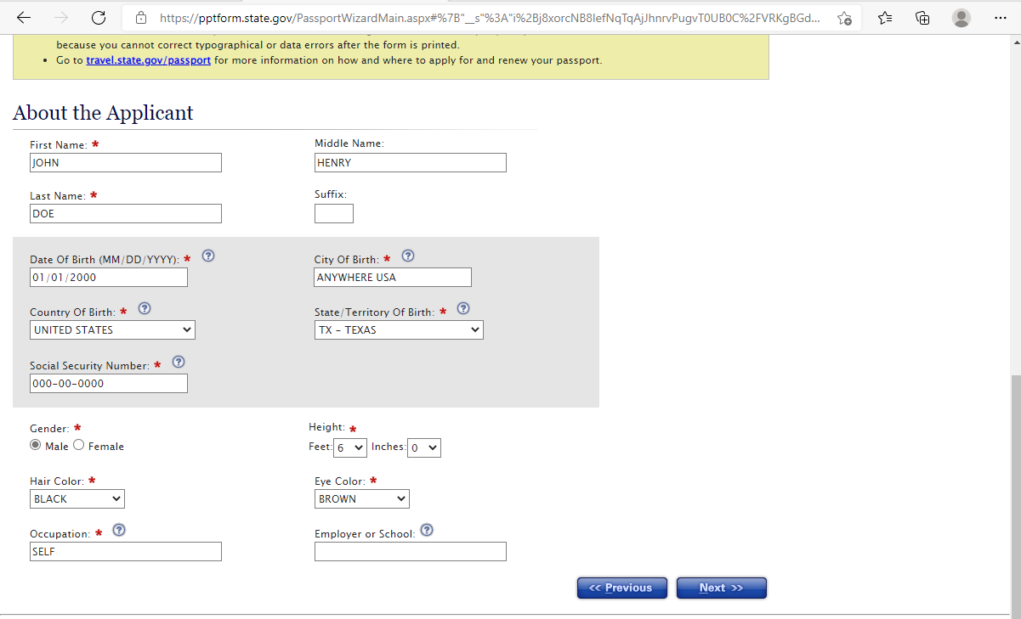
Complete the information about the applicant.

Slide 8
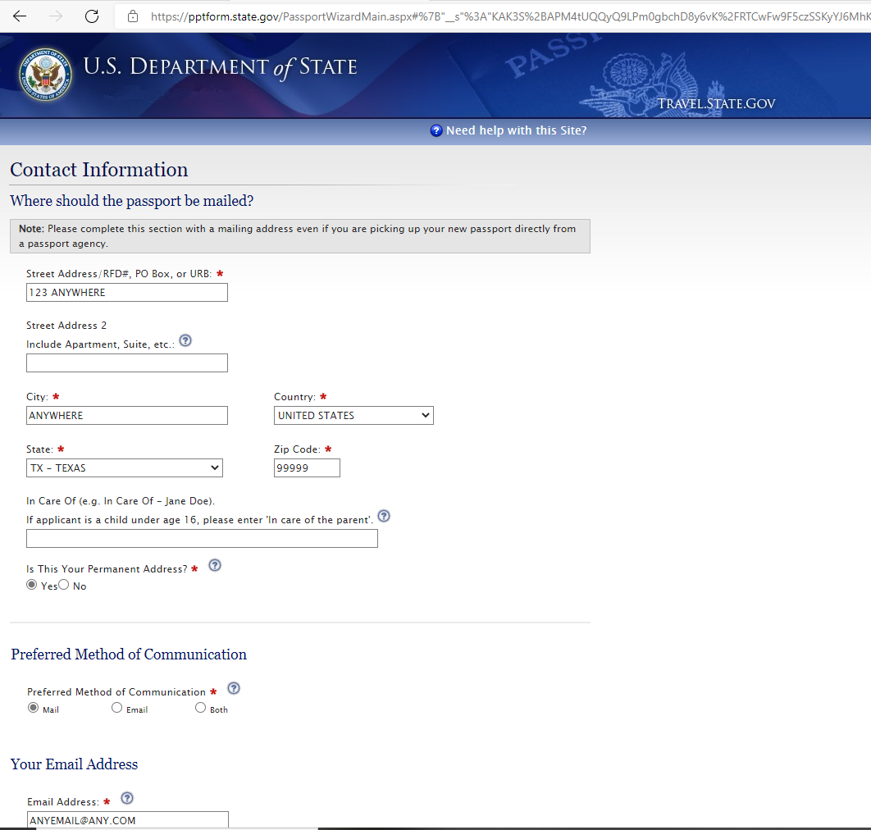
Continue filling out the application.

Slide 9
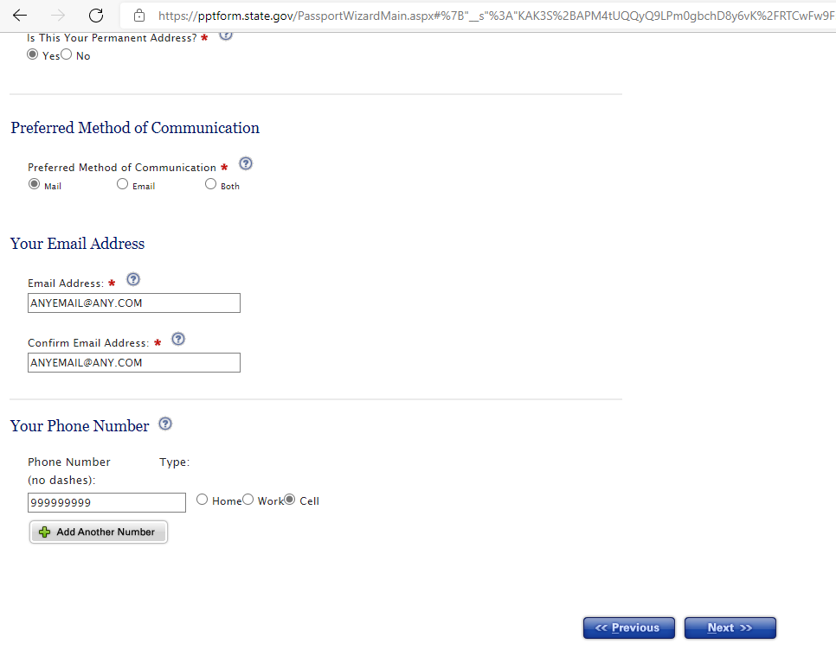

Slide 10
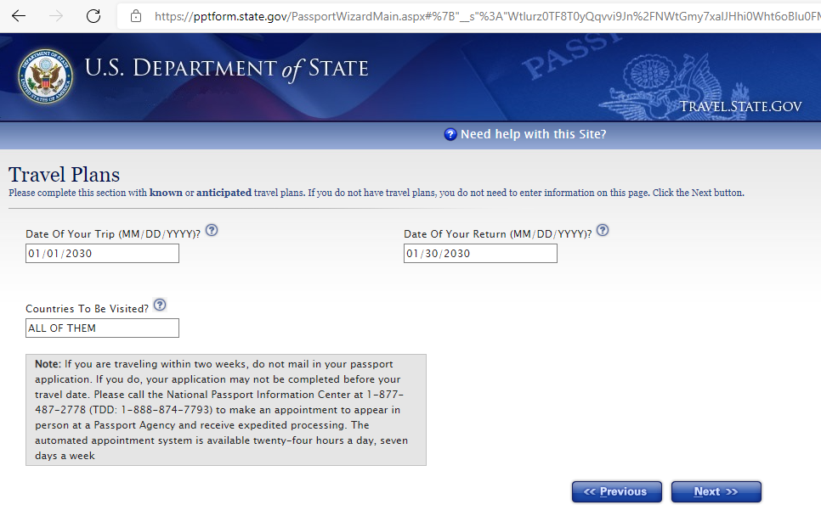

Slide 11
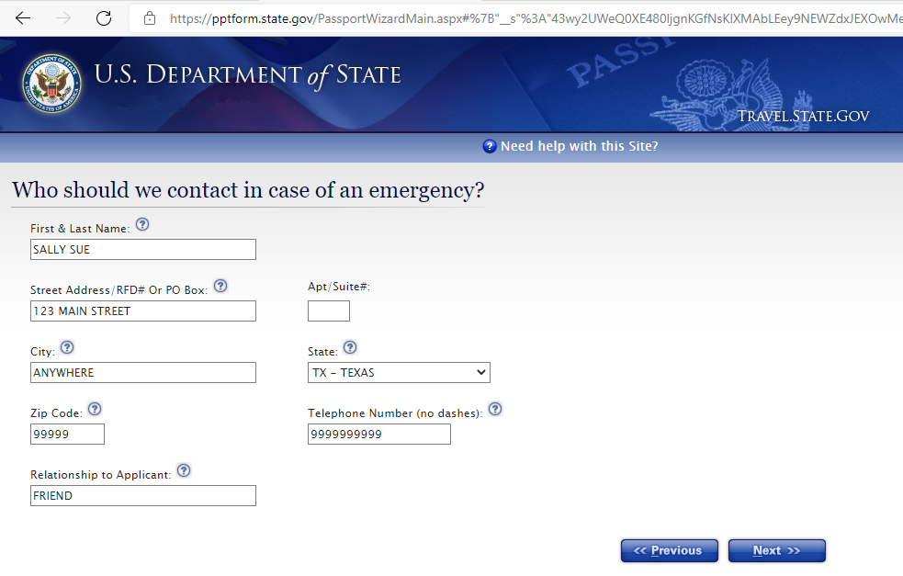

Slide 12
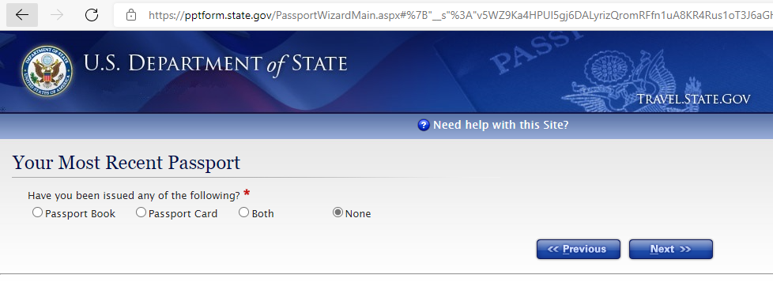

Slide 13
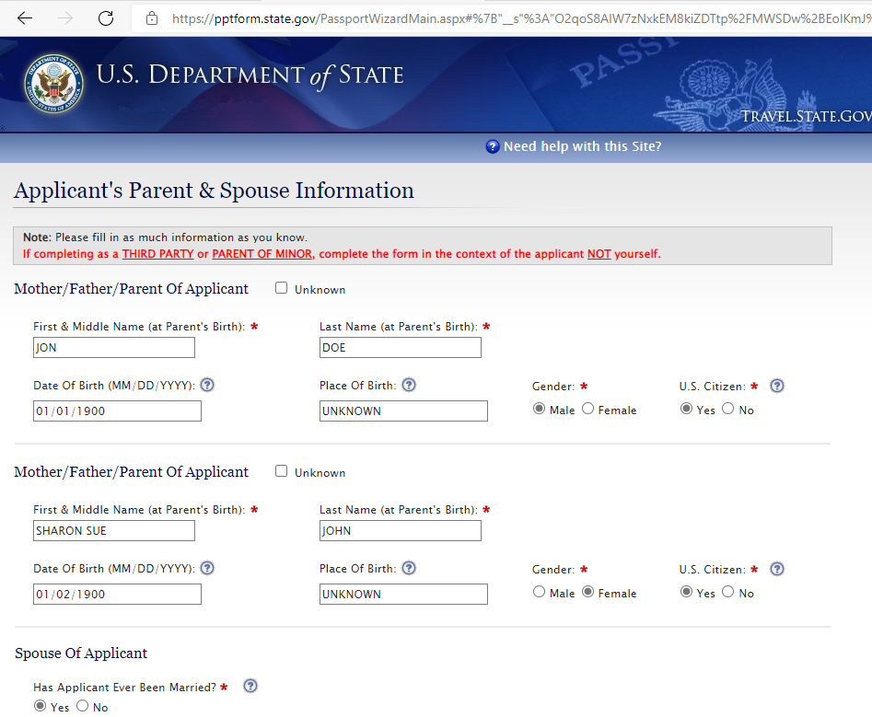
When entering the parent’s information, make sure the mother’s last name is her maiden name (her last name at her birth).

Slide 14
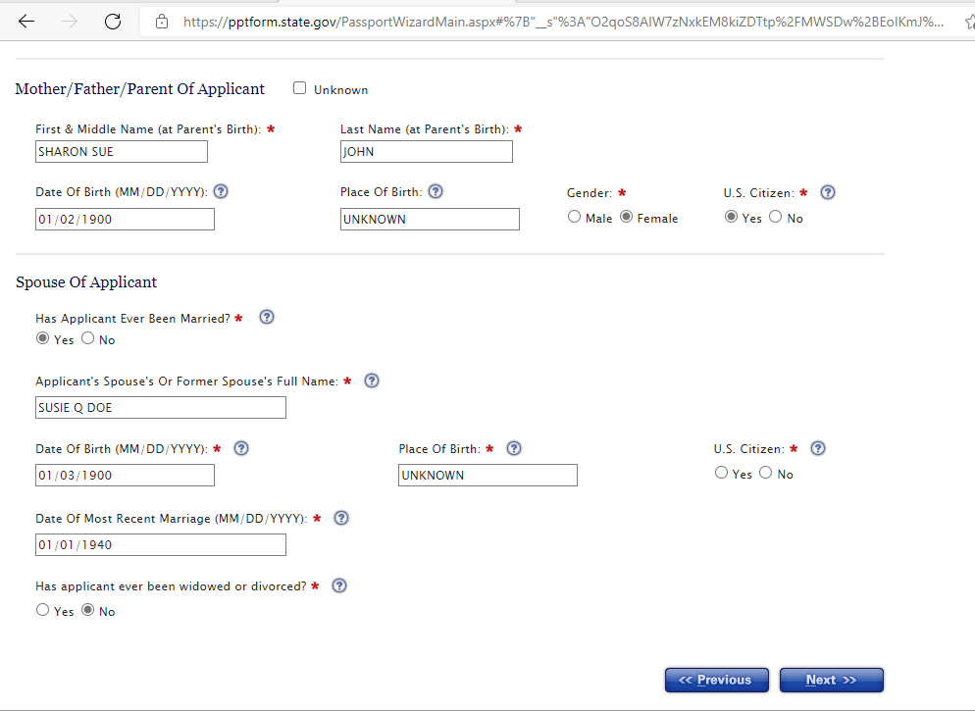

Slide 15
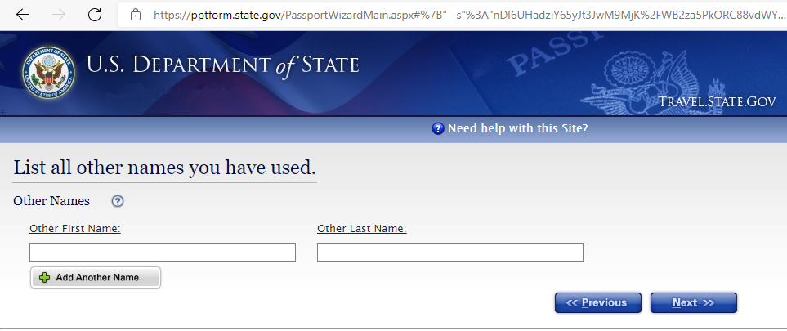
Enter any other names the applicant may have used.

Slide 16
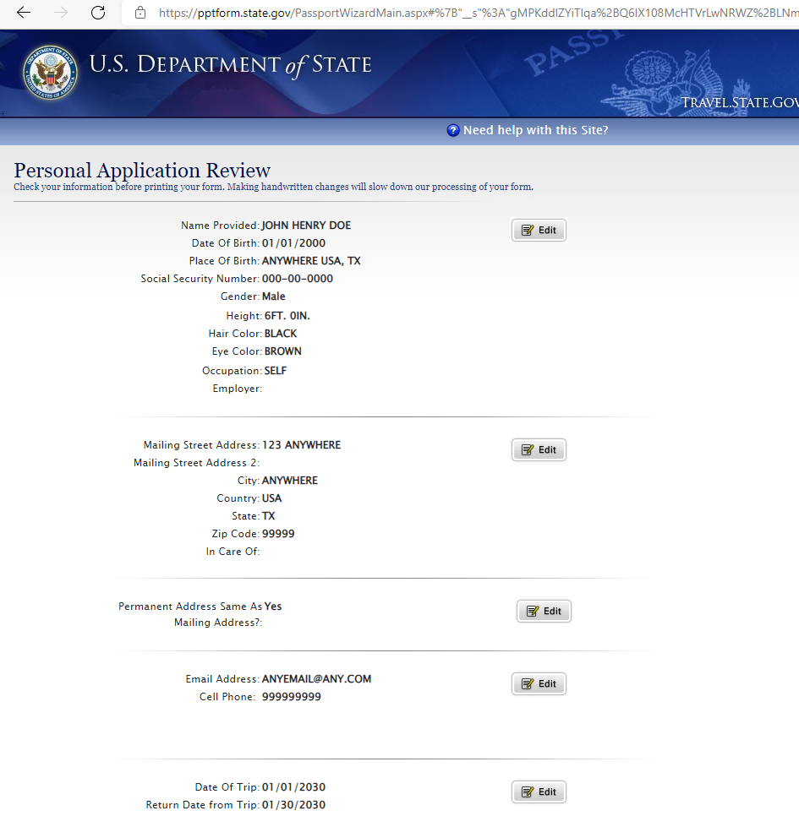
Review the information you have entered.

Slide 17
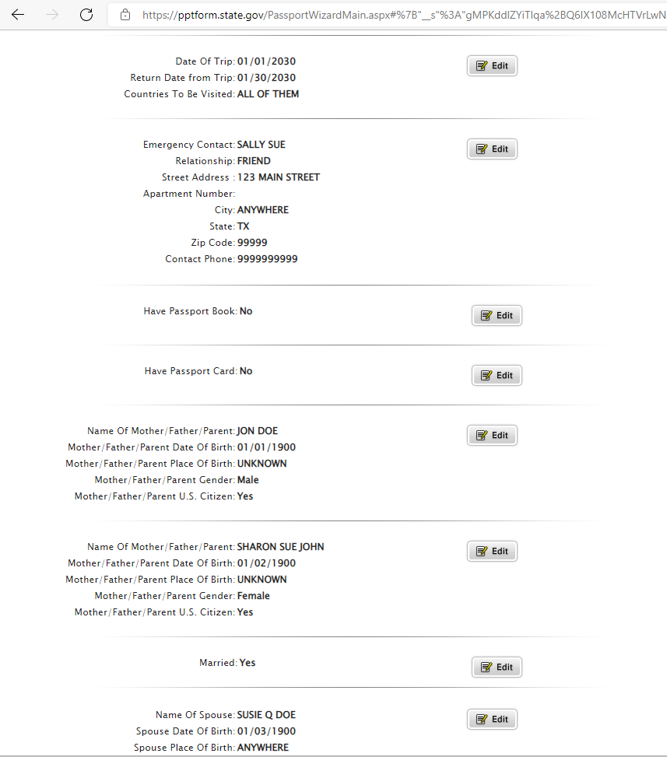
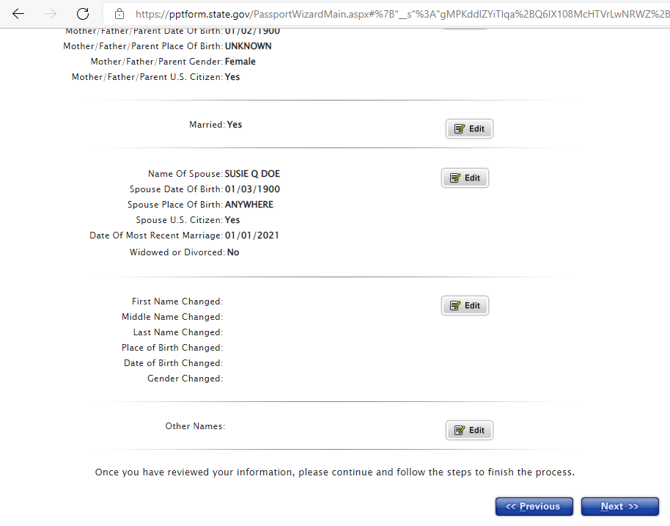

Slide 18
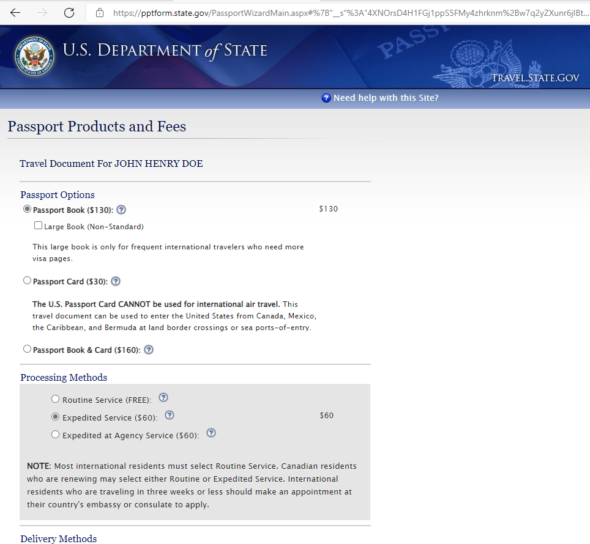
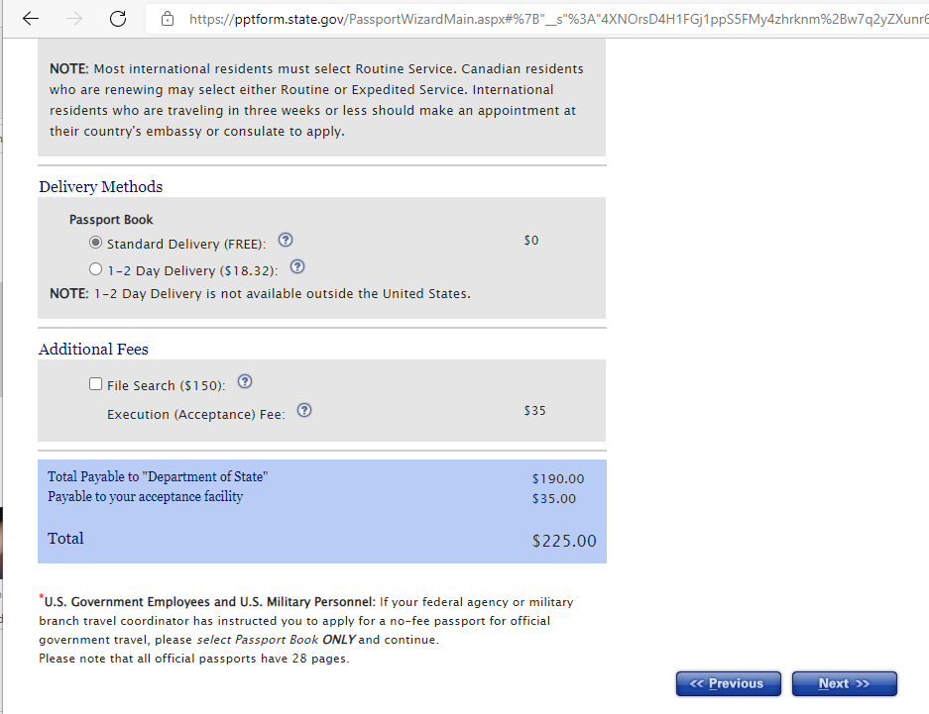
Please note: Passport Card is only good for land travel into Mexico and Canada. You cannot fly internationally with the card.

Slide 19
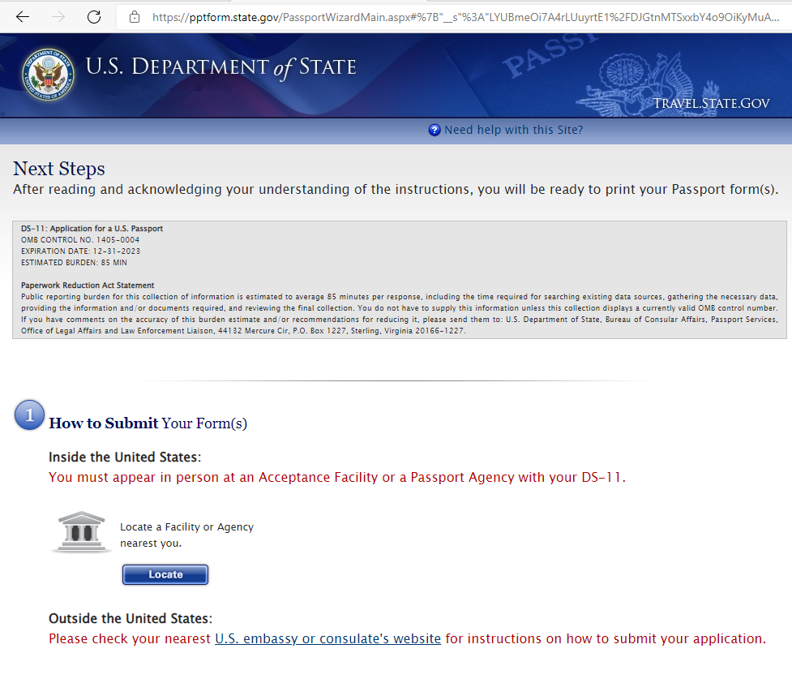
Austin County District Clerk’s office is located
265 N. CHESLEY ST, Suite 1 Bellville, Tx 77418
979-270-6830

Slide 20
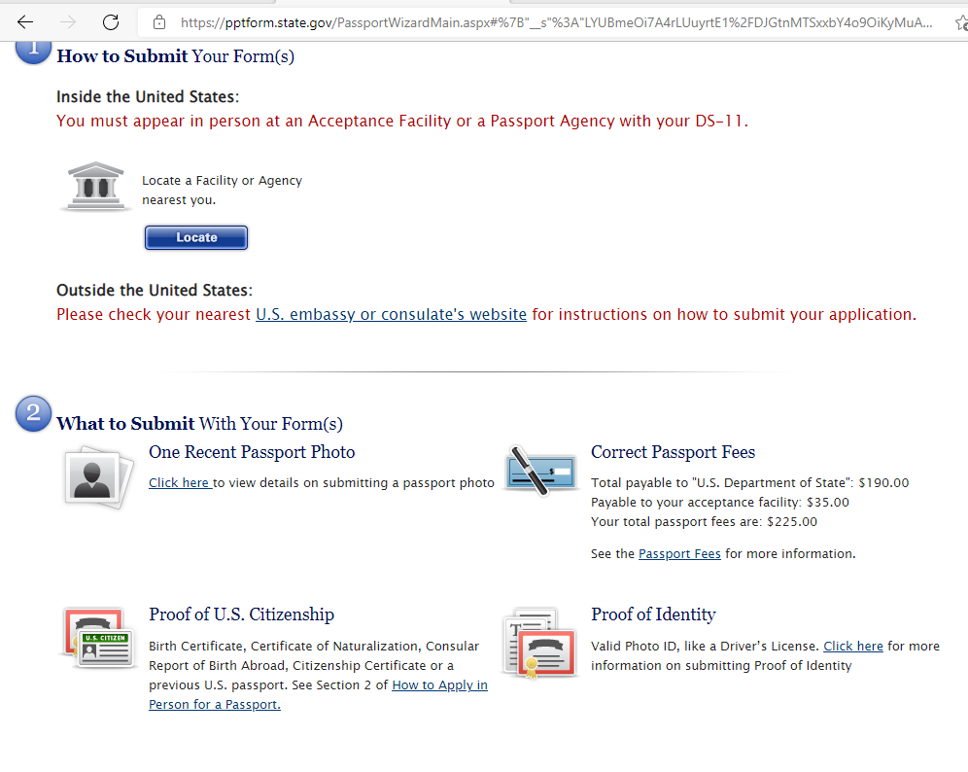

Slide 21
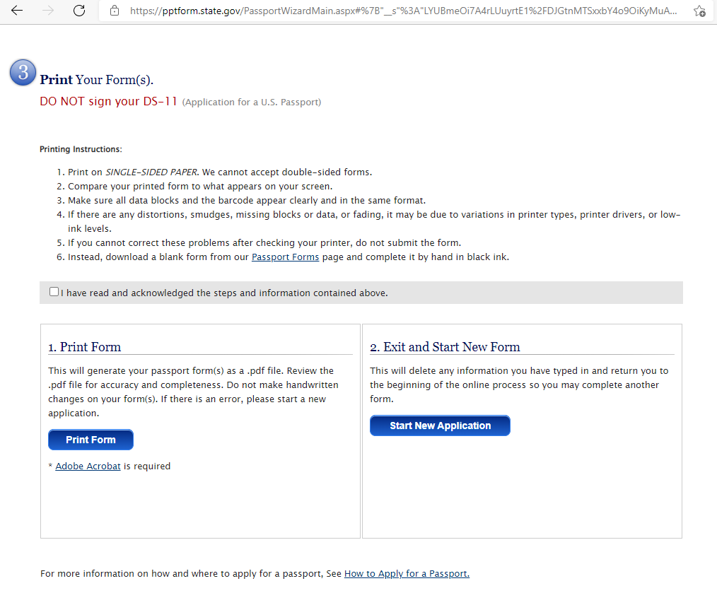
Print the application on separate sheets (do not print front and back).

Slide 22
PASSPORT APPLICATION CHECKLIST:
COMPLETED DS-11 APPLICATION
  DO NOT SIGN APPLICATION UNTIL REQUESTED TO DO SO BY A PASSPORT ACCEPTANCE AGENT
PROOF OF CITIZENSHIP
  PREVIOUSLY ISSUED U.S. PASSPORT UNDAMAGED (MAY BE EXPIRED) OR
  U.S. BIRTH CERTIFICATE OR CERTIFIED COPY ISSUED BY THE CITY, COUNTY OR STATE, OR
  CERTIFICATION OF NATURALIZATION OR
  CONSULAR REPORT OF BIRTH ABROAD OR CERTIFICATION OF BIRTH
  FOR MINORS: UNDER 18, THE ORIGINAL BIRTH CERTIFICATE MUST BE PRESENT
  NOTE: ORIGINAL PROOF OF CITIZENSHIP MUST BE SUBMITTED WITH YOUR APPLICATION. HOWEVER, YOUR ORIGINAL DOCUMENT WILL BE MAILED BACK TO YOU IN A SEPARATE ENVELOPE.
PASSPORT PHOTO:
  (1) 2X2 COLOR PHOTO CAN BE PURCHASED AT CVS OR WALGREENS
PROOF OF IDENTITY:
  VALID STATE DRIVER’S LICENSE OR GOVERNMENT ISSUED PHOTO IDENTIFICATION
  MINORS UNDER THE AGE OF 16 YEARS OF AGE, BOTH PARENTS MUST APPEAR AND HAVE VALLID ID.

Slide 23
Austin county district clerk’s office
265 N. CHESLEY STREET, SUITE 1
BELLVILLE, TX 77418
CALL TO SCHEDULE
AN APPOINTMENT
979-270-6830

